Slide 1
AB 1482
Is my rental unit subject to the rent cap provision?
Jonathan Black, Esq.

Slide 2
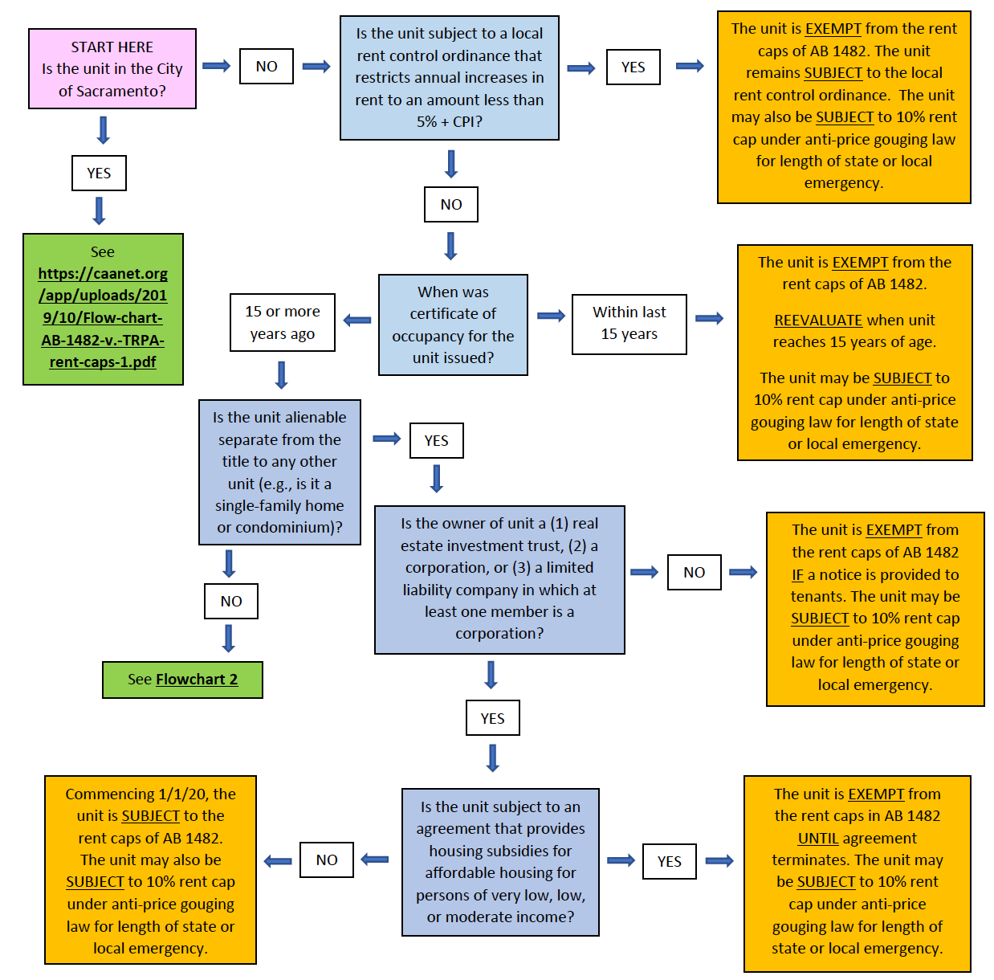

Slide 3
Subject to a local rent control ordinance?
Does the ordinance restrict annual increases in rent to an amount less than 5% + CPI?
If NO, then you will need to determine when the certificate of occupancy was granted.
If YES, then the unit is EXEMPT from the rent caps of AB 1482.
The unit remains SUBJECT to the local rent control ordinance.
The unit may also be SUBJECT to 10% rent cap under anti-price gouging law for length of state or local emergency.

Slide 4
Certificate OF OCCUPANCY
Within last 15 years?
The unit is EXEMPT from the rent caps of AB 1482.
Once the unit reaches 15 years of age, you’ll REEVALUATE because your unit may be SUBJECT to a 10% rent cap under anti-price gouging law for length of state or local emergency.
15 or more years ago?
Is the unit alienable separate from the title to any other unit (e.g., is it a single-family home or condominium)?

Slide 5
Single family or condominium?
YES?
Is the owner of unit a (1) real estate investment trust, (2) a corporation, or (3) a limited liability company in which at least one member is a corporation?
NO?
See Flowchart 2

Slide 6
REIT, CORP. or LLC?
YES?
Is the unit subject to an agreement that provides housing subsidies for affordable housing for persons of very low, low, or moderate income?
NO?
The unit is EXEMPT from the rent caps of AB 1482 IF a notice is provided to tenants. The unit may be SUBJECT to 10% rent cap under anti-price gouging law for length of state or local emergency.

Slide 7
SUBSIDIES?
YES?
The unit is EXEMPT from the rent caps of AB 1482 IF a notice is provided to tenants. The unit may be SUBJECT to 10% rent cap under anti-price gouging law for length of state or local emergency.
NO?
Commencing 1/1/20, the unit is SUBJECT to the rent caps of AB 1482. The unit may also be SUBJECT to 10% rent cap under anti-price gouging law for length of state or local emergency.

Slide 8
Single family or condominium?
NO?
See Flowchart 2

Slide 9
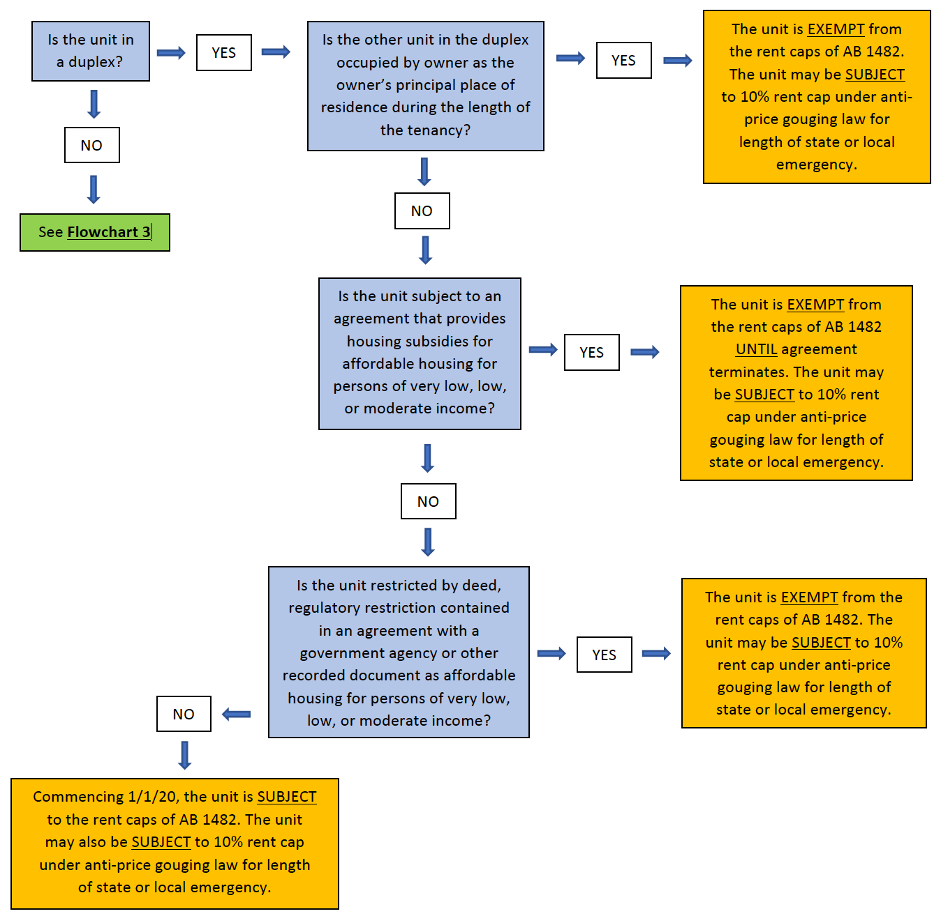

Slide 10
FLOW CHART 2
My rental unit:
(1) is not subject to local rent control,
(2) its certificate of occupancy was issued 15 or more years ago, AND
(3) it is not a single-family home or condominium.
Is it subject to the rent cap provisions of AB 1482?

Slide 11
Is the unit a DUPLEX?
YES?
Is the other unit in the duplex occupied by owner as the owner’s principal place of residence during the length of the tenancy?
NO?
See Flowchart 3

Slide 12
OWNER OCCUPIED?
YES?
The unit is EXEMPT from the rent caps of AB 1482 IF a notice is provided to tenants. The unit may be SUBJECT to 10% rent cap under anti-price gouging law for length of state or local emergency.
NO?
Is the unit subject to an agreement that provides housing subsidies for affordable housing for persons of very low, low, or moderate income?

Slide 13
SUBSIDIES?
YES?
The unit is EXEMPT from the rent caps of AB 1482 IF a notice is provided to tenants. The unit may be SUBJECT to 10% rent cap under anti-price gouging law for length of state or local emergency.
NO?
Is the unit restricted by deed, regulatory restriction contained in an agreement with a government agency or other recorded document as affordable housing for persons of very low, low, or moderate income?

Slide 14
Regulatory restriction in Gov’t agreement? Deed?
YES?
The unit is EXEMPT from the rent caps of AB 1482 IF a notice is provided to tenants. The unit may be SUBJECT to 10% rent cap under anti-price gouging law for length of state or local emergency.
NO?
Commencing 1/1/20, the unit is SUBJECT to the rent caps of AB 1482. The unit may also be SUBJECT to 10% rent cap under anti-price gouging law for length of state or local emergency.

Slide 15
Is the unit a DUPLEX?
NO?
See Flowchart 3

Slide 16
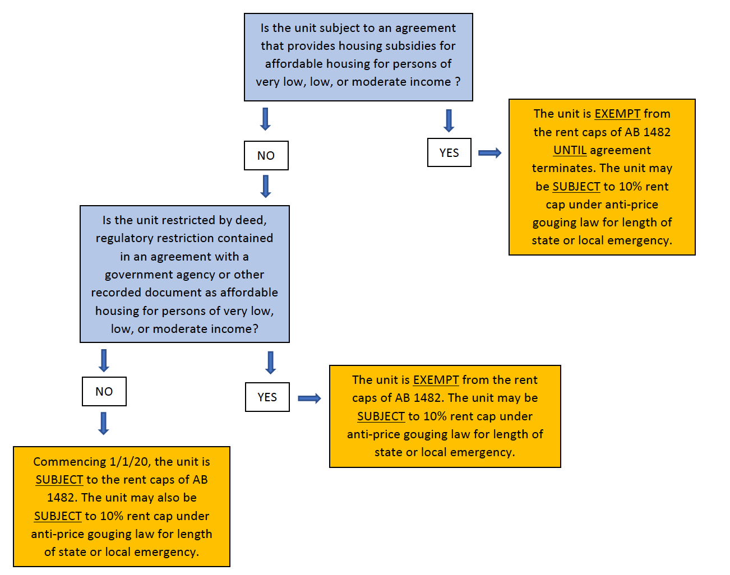

Slide 17
FLOW CHART 2
My rental unit:
(1) is not subject to local rent control,
(2) its certificate of occupancy was issued 15 or more years ago, and
(3) it is not a single-family home, condominium, or duplex.
Is it subject to the rent cap provisions of AB 1482?

Slide 18
SUBSIDIES?
YES?
The unit is EXEMPT from the rent caps of AB 1482 IF a notice is provided to tenants. The unit may be SUBJECT to 10% rent cap under anti-price gouging law for length of state or local emergency.
NO?
Is the unit restricted by deed, regulatory restriction contained in an agreement with a government agency or other recorded document as affordable housing for persons of very low, low, or moderate income?

Slide 19
Regulatory restriction in Gov’t agreement? Deed?
YES?
The unit is EXEMPT from the rent caps of AB 1482 IF a notice is provided to tenants. The unit may be SUBJECT to 10% rent cap under anti-price gouging law for length of state or local emergency.
NO?
Commencing 1/1/20, the unit is SUBJECT to the rent caps of AB 1482. The unit may also be SUBJECT to 10% rent cap under anti-price gouging law for length of state or local emergency.

Slide 20
Questions?
CONTACT ME:
Jonathan Black
WESTON LAW GROUP, PC
(925)362-3120
jonathan@westonlawpc.com
www.westonlawpc.com

